Slide 1
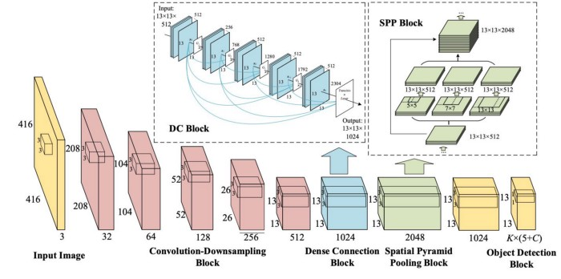
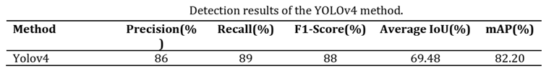
Architecture used in the paper
The newly developed YOLOV4 has been used for face mask detection. This study makes a detection in 3 classes with a mask, without a mask, and with a mask but not wearing it properly.
The dataset used in that paper containing 853 images (with different sizes) shared publicly on the Kaggle website was used, it has 3 mentioned classes, and the paper authors split the dataset into 80% training and 20% testing sets. The final results of the experiment on test data gave them a mAP (mean average precision) of 82.20%

Slide 2

Dataset details
The name of dataset used: Labeled Mask Dataset (YOLO_darknet).
The link of the dataset: https://www.kaggle.com/datasets/techzizou/labeled-mask-dataset-yolo-darknet
The total number of samples in the dataset: 1510 images
The dimension of images: various dimensions
Number of classes: 2 classes
Their labels: with mask / without mask
“This dataset contains 1510 images belonging to the 2 classes, as well as their bounding boxes in the YOLO format labeled text files.”

Slide 3

Implementation details
We made preprocessing steps following the yolov4 darknet official repo guidelines this pre-processing steps leads us to make the required structure for the data to start training.
such as :
change line batch to batch=64
change line subdivisions to subdivisions=16
change line max_batches to (classes*2000 but not less than the number of training images and not less than 6000), f.e. max_batches=6000 if you train for 3 classes
change [filters=255] to filters=(classes + 5)x3 in the 3 [convolutional] before each [yolo] layer, keep in mind that it only has to be the last [convolutional] before each of the [yolo] layers.
change line classes=80 to your number of objects in each of 3 [yolo]-layers.
So if classes=1 then it should be filters=18. If classes=2 then write filters=21

Slide 4
Implementation details
What are subdivisions?
It is the number of many mini-batches we split our batch into.
Batch=64 -> loading 64 images for one iteration.
Subdivision=16 -> Split batch into 8 mini-batches so 64/16 = 4 images per mini-batch and these 4 images are sent for processing
Create your “obj.data” and “obj.names” files and upload them to your drive
obj.data
The obj.data file has :
The number of classes.
The path to train.txt and test.txt files .
The path to obj.names file which contains the names of the classes.
The path to the training folder where the training weights will be saved.

Slide 5
Implementation details
Training ratio: 90% (1359)
Testing ratio: 6.6% (100)
Validation ratio: 3.4% (51)
Hyperparameters used:
Testing batch=1 Training batch=64
subdivisions=16 width=640
height=640 channels=3
momentum=0.949 learning_rate=0.001
max_batches = 6000

Slide 6
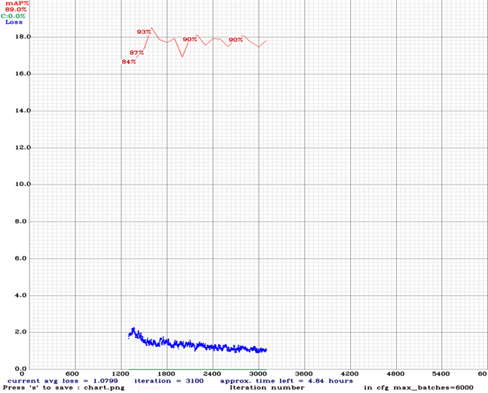
Results and visualization
Precision | Recall | F1-Score | Average IoU | mAP
0.94 | 0.96 | 0.95 | 73.93% | 98.70 %
Result details: (On testing data):
**The curve doesn’t go from up to down intensely because it’s the chart of the last training time.

